Slide 1
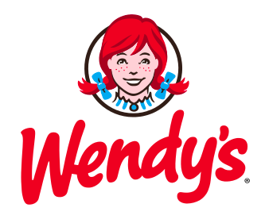
Sale Strategies
& Customers Segmentation
Group 3:
Arun Kumar
Xiang Ji
Juyeon Park
Shenxiangsu Zhang
Kaushik Konda

Slide 2
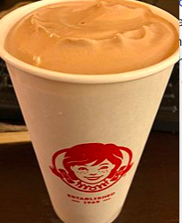
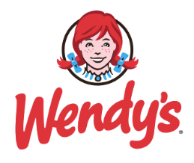
Agenda
Executive Summary
Segmentation
Analytic Techniques
Actionable Insights
Financial Implication

Slide 3
Executive Summary
The Wendy's Company (NASDAQ: WEN) is the world's third largest quick-service hamburger restaurant chain. The Wendy's system includes more than 6,500 restaurants in 29 countries and U.S. territories
Wendy’s vision statement is “to be the quality leader in everything we do.”
Wendy’s mission statement is “to deliver superior quality products and services for our customers and communities through leadership, innovation and partnerships.”
Business Objectives
Increase revenue by segmentation
Maximize profit with proper prices
Financial Implication
Total Revenue 9% increase by decreasing 10% of price ($75,058 --> $81,521)

Slide 4
Marketing Strategies
Customers segmentation
Diagnose feature of each segment
Analyze sales trend and total revenue
Know sensitivity to price of each segment by utilizing Elasticity Modeling
Decide what should we do to change price based on insights.

Slide 5
Segmentation
Wendy’s Hater:
Lowest share of sales, and low income. Hey leave me alone Wendy’s !
Healthy Rich:
High income and always eat healthy food as they can.
“I’m not a vegetarian, but I eat healthy.”
Busy Rich:
High income, but buy a lot, ”I’m in a hurry so just give me something to eat!”
New Comers:
Short tenure, “Hello, I heard about Wendy’s the first time. ”
Heavy Eaters:
Low income,
”To save money,
I only eat Wendy’s everyday. “

Slide 6
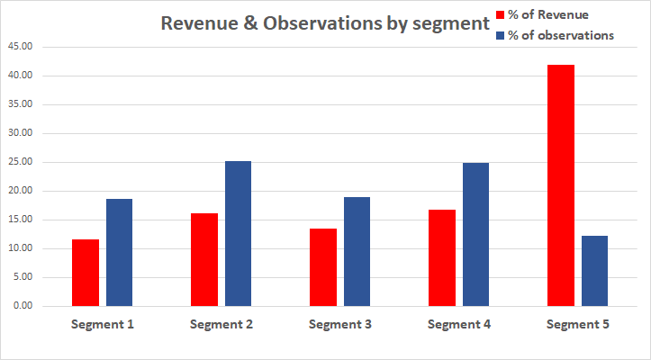
Segment Overview

Slide 7
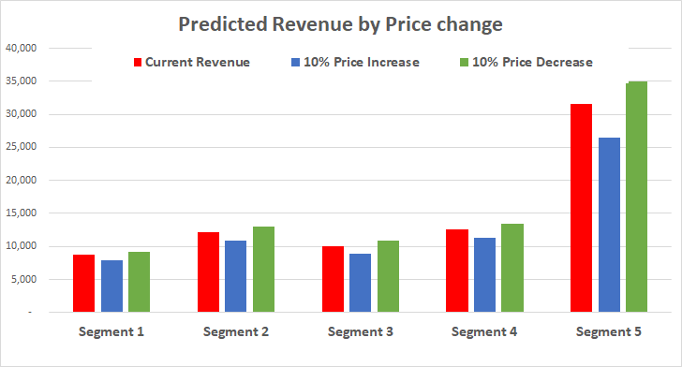
Predicted Revenue

Slide 8
Analytic Techniques
OLS
o
M
MARKET BASKET
ELASTICITY
s
E
SEGMENTATION

Slide 9
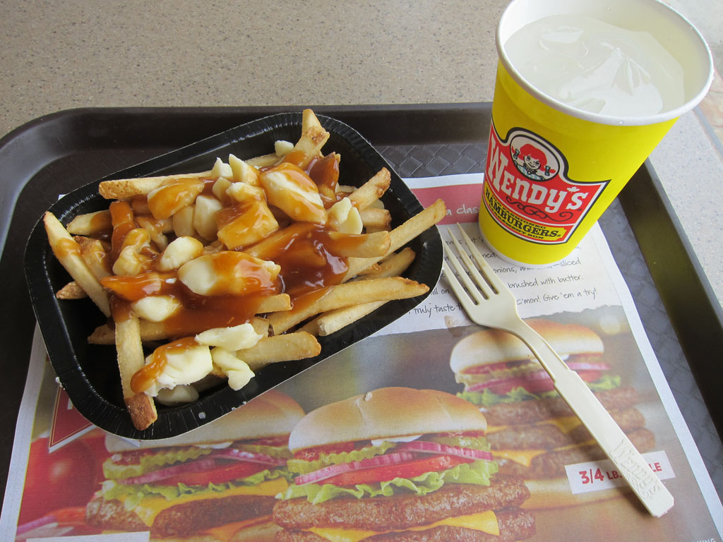
1. Wendy’s Haters
Characteristics
18.63% share of market
11.57% lowest revenue
Technique:
Market basket
Financial impact:
Revenue (△6%）: $8,682 → $9,711
( 10% decrease of price)
Beverage | Chicken, French fries, salad
Ham burger | French fries, Salad
chicken | French fries
French fries | Beverage, bakery
Salad | Beverage, bakery
Bakery | French fries
Meal deal | Chicken, French fries
From 2015

Slide 10
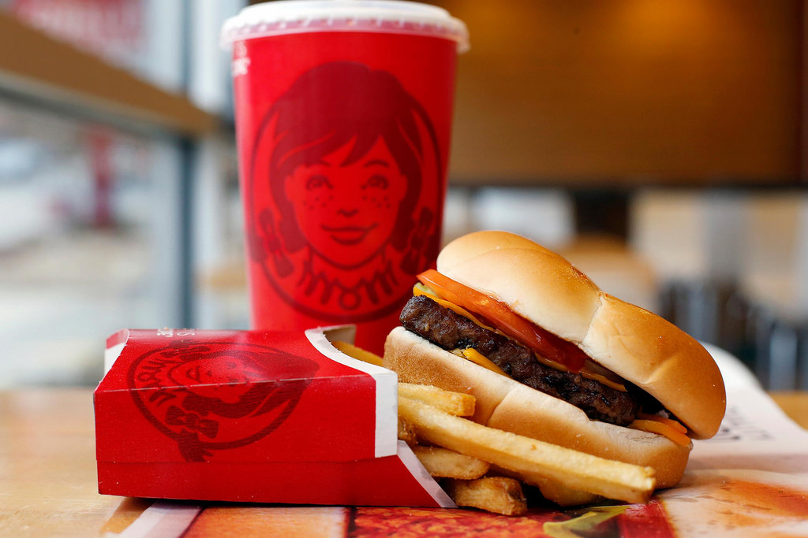
2. Healthy Rich
Characteristics:
25.20% share of market (largest)
16.18% share of revenue
Beverage | Bakery
Ham burger | French fries
chicken | French fries, salad, bakery
French fries | Beverage
Salad | chicken, bakery
Bakery | Chicken, French fries, salad
Meal deal | Chicken, French fries
Technique:
Market basket
Financial impact:
Revenue (△7%）: $12,146 → $13,008( 10% decrease of price)

Slide 11
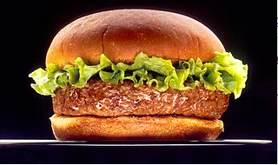
3. Busy Rich
Characteristics:
18.98% share of market
13.45% share of revenue
Beverage | Chicken, salad, bakery
chicken | bakery
French fries | Beverage
Salad | beverage
Bakery | Chicken, French fries, beverage
Meal deal | bakery
Technique:
Market basket
Financial impact:
Revenue (△8%）: $10,098 → $10,859 ( 10% decrease of price)

Slide 12
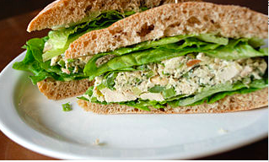
4. New Comers
Characteristics:
24.93% second largest share of market
16.82% share of revenue
Beverage | French fries, salad
Ham burger | French fries
chicken | French fries
French fries | Beverage, chicken, bakery
Salad | beverage
Bakery | French fries, beverage, meal deal
Meal deal | Bakery, chicken
Technique:
Market basket
Financial impact:
Revenue (△6%）: $12,623 → $13,426( 10% decrease of price)

Slide 13
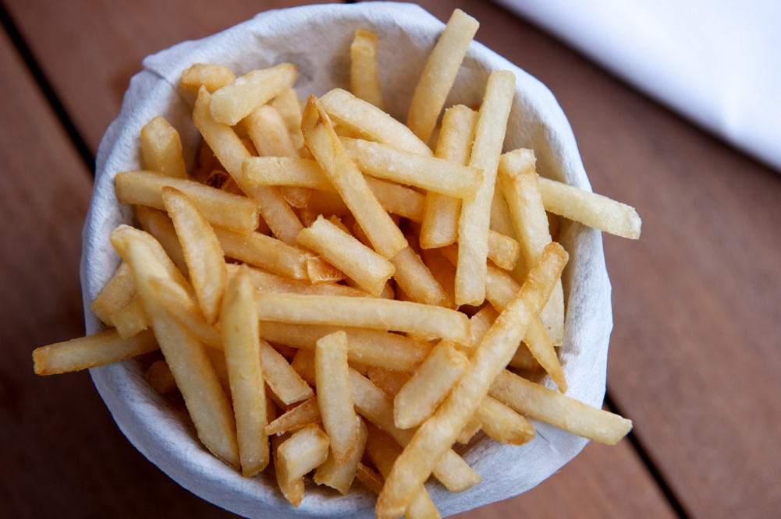
5. Heavy Eaters
Characteristics:
12.26% lowest share of market
41.98% biggest share of revenue
Technique:
Market basket
Financial impact:
Revenue (△11%）: $31,510 → $35,016
( 10% decrease of price)
Beverage | French fries
Ham burger | salad
chicken | French fries, salad, meal deal
French fries | chicken, French fries, beverage
Salad | chicken
Bakery | French fries, beverage, meal deal
Meal deal | French fries, chicken

Slide 14
Financial Implication
Segment | Current Revenue($) | Share of Revenue | New Revenue($) (10% Price Decrease) | △Percent of Revenue
Wendy’s Hater | 8,682 | 11.57% | 9,211 | 6%
Healthy Rich | 12,146 | 16.18% | 13,008 | 7%
Busy Rich | 10,098 | 13.45% | 10,859 | 8%
New Comers | 12,623 | 16.82% | 13,426 | 6%
Heavy Eaters | 31,510 | 41.98% | 35,016 | 11%
total | 75,058 | 100% | 81,521 | 9%
So by implementing this model the overall revenue of Wendy’s which is $300M will see a new high of $327M.

Slide 15
THANK
YOU
2018
PRESENTED BY GROUP 3

